Slide 1
Running head: Information Systems
Distinct Information Systems
Student’s Name
Institutional Affiliation
Date

Slide 2
Radiology
Definition: Radiology is the use of medical imaging specialty when it comes to diagnosis and treatment of diseases in the body.
Radiology in practice involves different healthcare professionals coming together and accomplishing radiology as a team.
The different types of techniques involve the use of radiology in their imaging activities.
Radiography, X-ray, Ultrasound, positron emission tomography and computed tomography are all techniques that involve radiology.
Radiology is broadly categorized into two; Interventional radiology and Diagnostic radiology.
Notes:
Radiology is broadly regarded as a science branch that utilizes radiant energy in the diagnosis and treatment of diseases. A scientist with specialty in radiology is referred to as a radiologist. The first images that were produced by radiology dates bac to 1895 by Rontgen and they were more of X-rays and they formed conventional radiology. This conventional radiography was inexpensive in its images as they could be cheaply obtained. However, this conventional radiology is disadvantageous as it has a limited range of the density that it is able to demonstrate and as well the use of ionization radiation poses danger.

Slide 3
Diagnostic radiology
A specialist in diagnostic radiology presents a last link in the diagnostic chain as relevant information is being sought in support of sound diagnosis.
Advantages:
Helps in studying the internal organs of the body.
Doctors can be able to diagnose the cause of symptoms of a certain condition.
Monitoring the responses of body to treatment
Screening different illnesses, example colon cancer, breast cancer and heart disease.
Notes:
However, the doses for radiation are high and therefore in every intended CT scan, there has to be a strict indicator. Ultrasonography is also a technique in radiology that is cheap and less harmless. Most physicians that are outside the field of radiology utilize ultrasonography. In the process of radiology, there is usage of ultrasound probes which utilize acoustic energy that is slightly above the human audible frequency in the production of images. There are no ionizing radiation that is accompanied in ultrasonography and therefore it makes it prevalent application in imaging of pregnant women and children.

Slide 4
Interventional radiology
In interventional radiology, radiologists use CT, MRI, ultrasound and fluoroscopy in guiding procedures.
Imaging helps the doctor to insert catheters , wires as well as other instruments into the body. Typically, interventional radiology allows for small incisions on the body.
Helps in diagnosing and treating conditions in any body part.
Often involved in the treatment of cancers, tumors and blockages.
Notes:
Interventional radiology involves the use of imaging which aids in the insertion of objects into the body. It involves the application of other techniques like the CT scans, Ultrasound and Magnetic Resonance imaging. The radiologists in interventional radiology are involved in the treatment of cancers, artery as well as vein blockages, uterine fibroid, back pains , problems of the liver and kidney problems. Doctors may make no incisions or as well they make very small incisions .

Slide 5
Surgical
Surgical is a condition that is related to surgery and surgeons.
The process is characterized by extreme precision and incisiveness.
As a process of surgery, it is a technology that consists of physical interventions on the tissues of the body.
The doctors that perform the surgical procedures are called surgeons.
Notes:
As a general rule, any procedure will be considered surgical when it involves the cutting of the tissues of the patient as well as closing of a wound that was previously sustained. However, there are other procedures like angioplasty and endoscopy which do not fall into this category but are sometimes considered surgery since they involve the common surgical procedures or are done in surgical environments like sterile environment, use of antiseptics, anesthesia and other typical surgical equipment.

Slide 6
Types of surgery
There are a number of surgery which basically involves a number of surgical procedures.
Semi-elective surgery
Elective surgery
Emergency surgery
Cosmetic surgery
Exploratory surgery
Amputation
Notes:
The different types of surgical procedures are mainly categorized from their urgency, type of procedure, the system of the body involved, the degree of invasion and the special instrument used. Elective surgery is done based on timing and it is done to correct a condition that is not life-threatening. Non-elective surgery is done so that a permanent disability can be avoided. Explorative surgery is done based on purpose. It is done to confirm a diagnosis of a certain condition. Cosmetic surgery as well is done based on purpose and that is the improvement of the appearance of an already normal organ structure.

Slide 7
List of surgical procedures
There are many surgical procedures that can be performed.
Excision surgery
Procedures that involves cutting into an organ-ending with -onomy
Minimal invasive procedures.
Procedures for formation of openings that are semi-permanent or permanent.
Reconstruction and repair of damaged
Notes:
Many of the names of the surgical procedures ae denoted with some suffixes to indicate the meaning. For instance, gastrectomy ends with the suffix -ectomy which means the removal of part of a body. Gasto- refers to stomach and thus, gastrectomy is the surgical removal of stomach. Besides, otomy refers to cutting into a body part. Gastrotomy is therefore cutting into and does not necessarily mean removing the stomach.

Slide 8
Description of surgical procedures
The description of the surgical procedures can be in the form of;
Location,
Pre-operative care and,
Staging for surgery
Post-operative care
Notes:
In patient surgeries are performed in healthcare facilities. In hospitals, operating theaters is used as the location for the operation and the use of operation equipment. There has to be a operating table for surgery. The preoperative care is the medical examination that has to be done on the patient prior to surgery. The physical status of a patient ha o be rated according to the stipulations put forward by ASA classification of physical status. Some systems in medical practices have routinely established the chest x=ray performance before a person undergoes a surgical procedure. In the staging for surgery, the preparations for surgery are done like the changing of clothes and recording of some vital signs. There is administration of anesthesia which prevents pain during the surgery. During surgery, an incision is made to access the site for surgery. During this process, there can be clamping of cauterization of blood vessels so as bleeding is prevented. After the surgery is over, the patient is then transferred to te unit of post-anesthesia care.

Slide 9
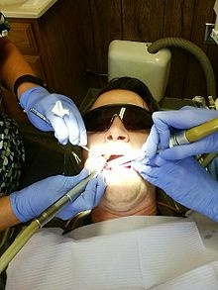
Dental
Dental is the aspect of dentistry that looks at the issues concerning the oral cavity.
Dental can involve surgery and thus dental surgeon is known as the dentist.
A dental surgeon is involved with the diagnosis, prevention and treatment of the oral cavity diseases as well as conditions.
Dentists help in provision of oral health services.
Notes:
The oral cavity can form one of the worst pains that an individual can experience due to problems. For better health there should be routine check up for any problem. The oral cavity requires oral hygiene which is the practice of keeping the mouth clean and free from any disease and bad breath. There needs to be regular brushing and cleaning of teeth. The oral hygiene should be carried out regularly so that there can be prevention of any dental disease.

Slide 10
Dental surgery
Dental surgery is one of the procedures involved in dentistry which involves the artificial modification of dentition (surgery of tooth, gum and bones of jaw).
There are several types of dental surgery including;
Endodontic- which involves surgery of the pulp
This is divided into root canal treatment and apicoectomy
Prosthodontics- this is the prosthetics of the dentals.
It involves the crown, veneers, bridge, and implant.
Notes:
There are several surgical procedures that can be done on the oral cavity. Root canal treatment involves pulpotomy, which is the opening of the pulp chamber so as an infection can be allowed to drain. It also involves pulpectomy, which is the removal of the pulp from the pulp chamber so that pain can be temporarily be relieved. Apicoectomy is the resection of the root end since the root canal alone can relieve pain and thus entering through the gingiva can aid in surgery and removal of the material that is diseased. Apicoectomy can be done by extraction of Fiberotomy.

Slide 11
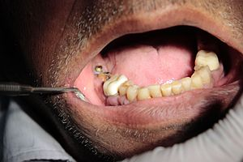
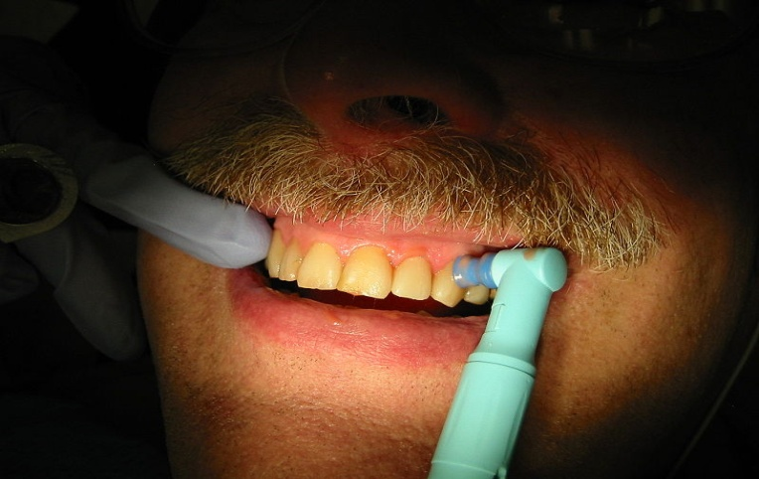
Professional dental care
There needs to be a most frequent cleaning of teeth and examination other than usual.
Cleaning is supposed to be thorough when there are disorders to be treated or following a recent dental surgical procedure.
Dental implants requires to be cleaned thoroughly as well.
Notes:
According to the American Dental Association, people need to visit dentists regularly, but the frequency will depend on the personal needs. There are people who need to go there frequently while others can visit even once a year. There can be x-rays and identification of dental plaque as routine check-up for the oral cavity.

Slide 12
References
Claydon NC (2008). "Current concepts in toothbrushing and interdental cleaning". Periodontology 2000. 48: 10–22.
Darby M, Walsh MM (2010). Procedures Manual to Accompany Dental Hygiene: Theory and Practice. St. Louis, Mo.: Saunders/Elsevier.
Lemos P, Jarrett P, Philip B, eds. (2006). Day surgery: development and practice (PDF). London: International Association for Ambulatory Surgery. ISBN 978-989-20-0234-7.
Mettler FA Jr. Introduction. In: Mettler FA Jr, ed. Essentials of Radiology. 3rd ed. Philadelphia, PA: Elsevier Saunders; 2014:chap 1.
Watson N. General notes. In: Watson N, ed. Chapman & Nakielny's Guide to Radiological Procedures. 6th ed. Philadelphia, PA: Elsevier; 2014:chap 1.
Notes:
According to the American Dental Association, people need to visit dentists regularly, but the frequency will depend on the personal needs. There are people who need to go there frequently while others can visit even once a year. There can be x-rays and identification of dental plaque as routine check-up for the oral cavity.

